Slide 1
Operation Analytics and Investigating Metric Spike
Project By: Sangeeta Kolkar

Slide 2
Project Description
Operation Analytics is the analysis done for the complete end to end operations of a company. With the help of this, the company then finds the areas on which it must improve upon. You work closely with the ops team, support team, marketing team, etc and help them derive insights out of the data they collect. Being one of the most important parts of a company, this kind of analysis is further used to predict the overall growth or decline of a company’s fortune. It means better automation, better understanding between cross-functional teams, and more effective workflows. Investigating metric spike is also an important part of operation analytics as being a Data Analyst you must be able to understand or make other teams understand questions like- Why is there a dip in daily engagement? Why have sales taken a dip? Etc. Questions like these must be answered daily and for that its very important to investigate metric spike.

Slide 3
Case Study 1 (Job Data)
The table job_data contains following columns:
job_id: unique identifier of jobs
actor_id: unique identifier of actor
event: decision/skip/transfer
language: language of the content
time_spent: time spent to review the job in seconds
org: organization of the actor
ds: date in the yyyy/mm/dd format.
Use the dataset then answer the questions that follows:
Number of jobs reviewed: Amount of jobs reviewed over time. Your task: Calculate the number of jobs reviewed per hour per day for November 2020?
Throughput: It is the no. of events happening per second. Your task: Let’s say the above metric is called throughput. Calculate 7 day rolling average of throughput? For throughput, do you prefer daily metric or 7-day rolling and why?
Percentage share of each language: Share of each language for different contents. Your task: Calculate the percentage share of each language in the last 30 days?
Duplicate rows: Rows that have the same value present in them. Your task: Let’s say you see some duplicate rows in the data. How will you display duplicates from the table?

Slide 4
Design and Software Used
Steps taken to load the table “job_data” into the database:
Software used for quering the results – MySQL Workbench 8.0
I have created a database using “create db” function of SQL
Imported the table into the database using GUI option “Table Data Import Wizard”

Slide 5


Task A
Number of jobs reviewed: Amount of jobs reviewed over time.
Task: Calculate the number of jobs reviewed per hour per day for November 2020?
Query for Distinct jobs:
select (count(distinct job_id)/(30*24)) as jobs_reviewed_per_day_distinct from project3
Query for Non-Distinct jobs:
select (count( job_id)/(30*24)) as jobs_reviewed_per_day from project3
Results:

Slide 6
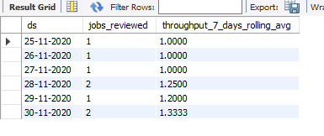
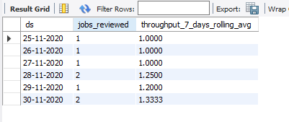
Task B
Throughput: It is the no. of events happening per second.
Task: Let’s say the above metric is called throughput. Calculate 7 day rolling average of throughput?
Query for Distinct jobs:
select ds, count(distinct job_id) as jobs_reviewed,
avg(count(distinct job_id)) over(order by ds rows between 6 preceding and current row) as throughput_7_days_rolling_avg
from project3
group by ds
Query for Non-Distinct jobs:
select ds, count(job_id) as jobs_reviewed,
avg(count(job_id)) over(order by ds rows between 6 preceding and current row) as throughput_7_days_rolling_avg
from project3
group by ds

Slide 7
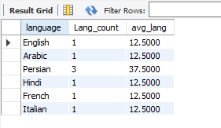
Task C
Percentage share of each language: Share of each language for different contents.
Task : Calculate the percentage share of each language in the last 30 days?
Query:
select language, count(language) as Lang_count, (count(language)/count(*))*100 as avg_lang
from project3
group by language
Result:

Slide 8
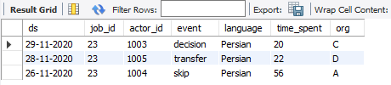
Task D
Duplicate rows: Rows that have the same value present in them.
Task: Let’s say you see some duplicate rows in the data. How will you display duplicates from the table?
Query:
select a.*
from project3 a
Join (select job_id, count(*) from project3
group by job_id
having count(*)>1) b
on a.job_id=b.job_id
Result :

Slide 9
Case Study 2 (Investigating metric spike)
Table-1: users This table includes one row per user, with descriptive information about that user’s account.
Table-2: events This table includes one row per event, where an event is an action that a user has taken. These events include login events, messaging events, search events, events logged as users progress through a signup funnel, events around received emails.
Table-3: email_events This table contains events specific to the sending of emails. It is similar in structure to the events table above.
Answer following questions using above datasets:
User Engagement
User Growth
Weekly Engagement
Email Engagement

Slide 10
Task A
User Engagement: To measure the activeness of a user. Measuring if the user finds quality in a product/service. Task: Calculate the weekly user engagement.
Query:
SELECT EXTRACT(WEEK FROM OCCURRED_AT) AS WEEK_NUMBER,
COUNT(DISTINCT USER_ID)
FROM tutorial.yammer_events
GROUP BY WEEK_NUMBER
Result:
https://drive.google.com/file/d/1cOJ2QumQT078dRfKIK4jfGMYbiqG_eVD/view?usp=sharing

Slide 11
Task B
User Growth: Amount of users growing over time for a product. Your task: Calculate the user growth for product?
Query:
select year, weeknum, num_active_user,
sum(num_active_user) over(order by weeknum rows between unbounded preceding and current row) as cummulative_active_users
FROM(
select extract(year from a.activated_at) as year,
extract(week from a.activated_at) as weeknum,
count(distinct user_id) as num_active_user
From tutorial.yammer_users a
Where state='active'
group by year, weeknum
) a
Result:
https://drive.google.com/file/d/1-2BqXSLm2Cn5mHrfKcv9GncIBKukJcN1/view?usp=sharing

Slide 12
Task C
Weekly Engagement: To measure the activeness of a user. Measuring if the user finds quality in a product/service weekly. Your task: Calculate the weekly engagement per device?
Query:
select extract(year from occurred_at) as year,
extract(week from occurred_at) as week,
device,
count( distinct user_id)
from tutorial.yammer_events
where event_type='engagement'
group by 1,2,3
order by 1,2,3
Result:
https://drive.google.com/file/d/1poI-Umz67WOTNEX1xTM-PUFmArWMDFA_/view?usp=sharing

Slide 13

Task D
Email Engagement: Users engaging with the email service. Your task: Calculate the email engagement metrics?
Query:
select
100.0*SUM(case when email_category='email_opened' then 1 else 0 end)/sum(case when email_category='email_sent' then 1 else 0 end )
as email_opening_rate,
100.0*SUM(case when email_category='email_clicked' then 1 else 0 end)/sum(case when email_category='email_sent' then 1 else 0 end )
as email_clicking_rate from (
select *,
case
when (action='email_open') then 'email_opened'
when (action='email_clickthrough') then 'email_clicked'
when action in ('sent_weekly_digest', 'sent_reengagement_email') then 'email_sent'
end as email_category
from tutorial.yammer_emails
) a
Result:

Slide 14
Thank You

